Slide 1
ETL Project Anesthesia Compliance Management
Kent Rodgers
December 10, 2020

Slide 2
Project Overview

Slide 3
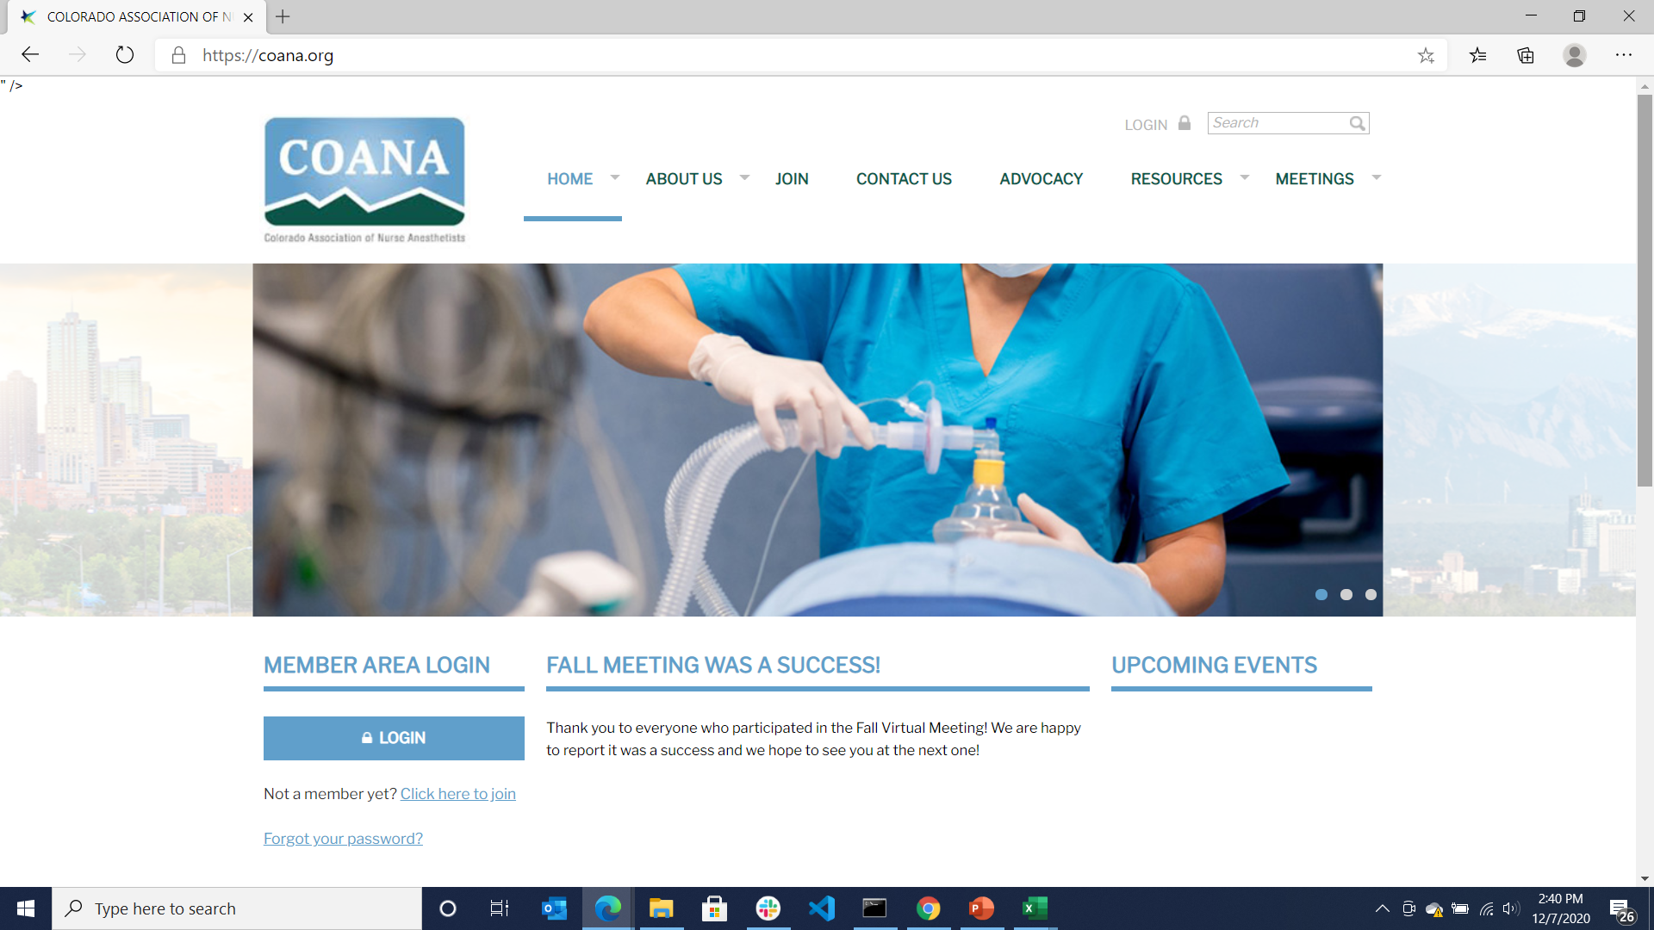
Colorado has 1252 actively licensed non-physician anesthesia clinicians
The primary purpose of these clinicians is to keep a patient comfortable and alive during a medical procedure.
These professionals require extensive training and credentials to practice.
More than 85% are Certified Registered Nurse Anesthestists (CRNA’s).

Slide 4
Problem Statement
Managing Nurse Anesthetists licensing is complicated
… and if not done properly can be costly
A Nurse Anesthetist is an advanced practice nurse and must maintain two licenses concurrently a) Advanced anesthesia b) underlying RN
“Compact” licensing permits the two licenses to be issued from separate states which makes it harder to ensure compliance
It can be interpreted as fraud if a Nurse Anesthetist bills Medicare while either license is expired or out of compliance. This can result in refunds, fines, loss of license due to censure and contract breach

Slide 5
Project Overview
Develop an improved process for managing non-physician anesthesia licensing compliance
Extract
Colorado Professional License file with approximately 1.2 million licenses including healthcare works, plumbers, electricians etc.
Filter this master file into in a Registered Nurse and a separate Anesthesia license file.
Create a fictitious employee file that is representative of an anesthesia practice team roster (utilized public information)
Stage it for project use and github repository. The original file was too big to push to github
Cleaning:
Remove excess columns
Establish a protocol to deal with duplicate but relevant many (license types) to one clinician
Create a matching element for each clinician to enable merging/joining of licensing and employee data
Stage clean and simplified files for placement into a relational database
Load
Author an ERD for planning and archive purposes
Create the table schema and tables in PGAdmin
Import the ‘transformed’ licensing and employee files into the PGAdmin tables
Prepare compliance reports in PGAdmin
See the value
Produce two compliance reports to establish a process and format for timely employee compliance
Produce two exception reports to establish a timely process for identifying and tracking at risk licensing issues

Slide 6
Extract Source & Highlights

Slide 7
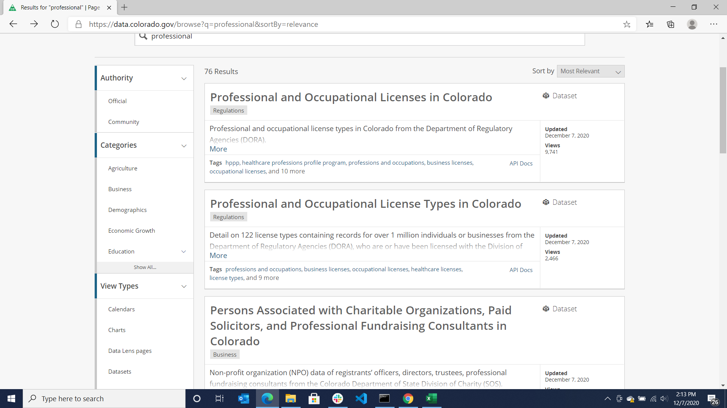
The primary licensing information was sourced from the State of Colorado a the data.Colorado.gov site presented in the image herein.

Slide 8
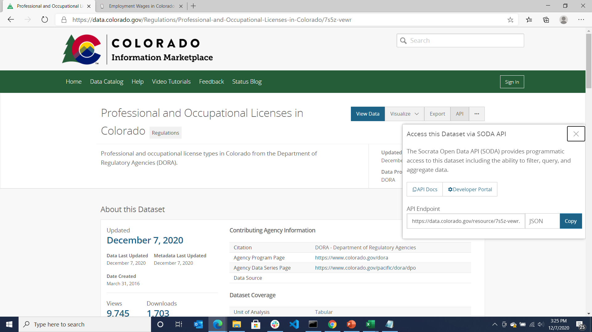
A large CSV file was downloaded to complete the project. The file is updated daily and an API is available that could be utilized to support a regular cadence or even a compliance application.

Slide 9
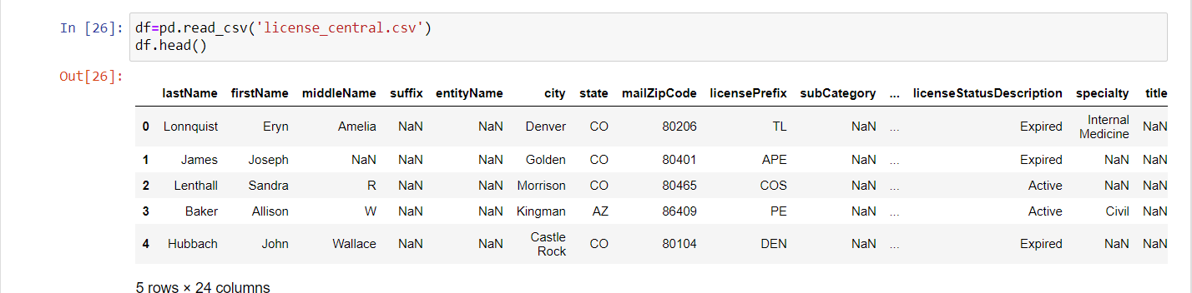
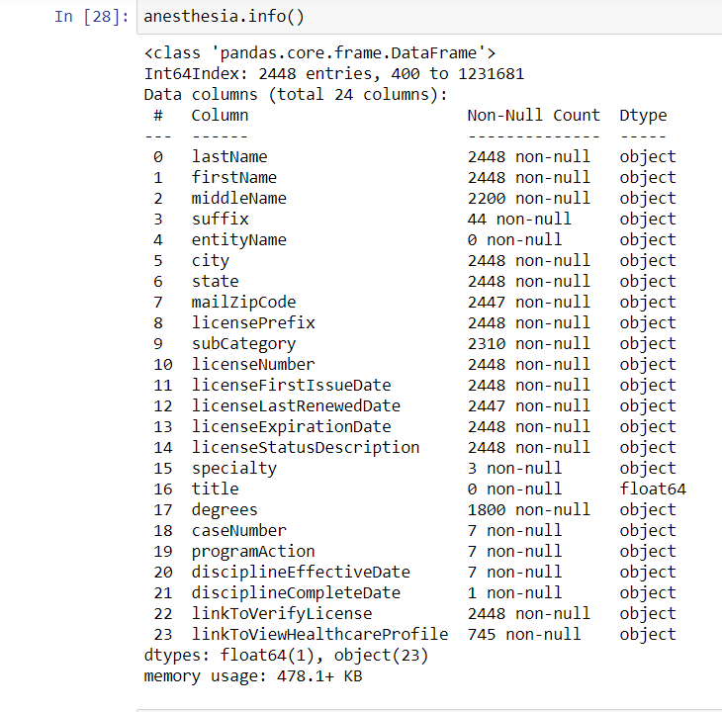
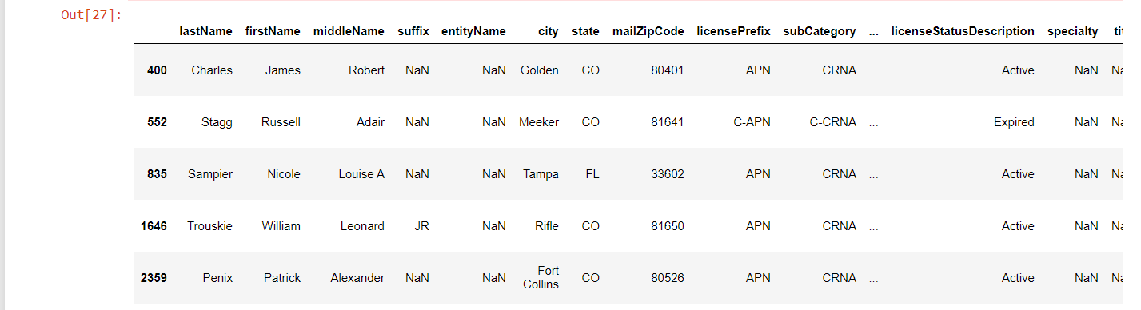
Anesthesia File Example

Slide 10
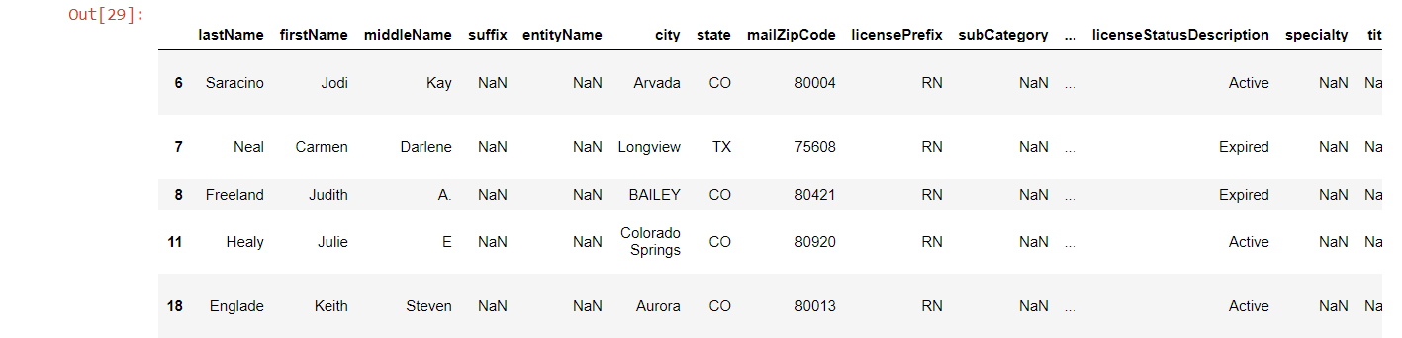
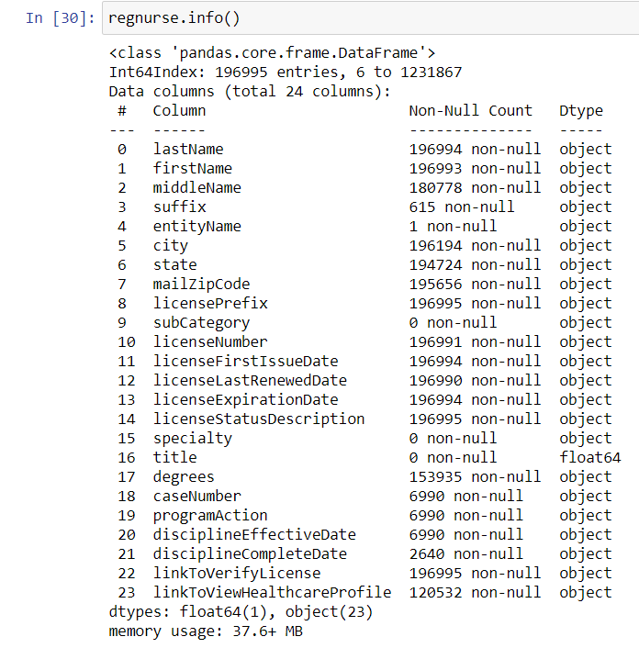
Nurse File Example

Slide 11
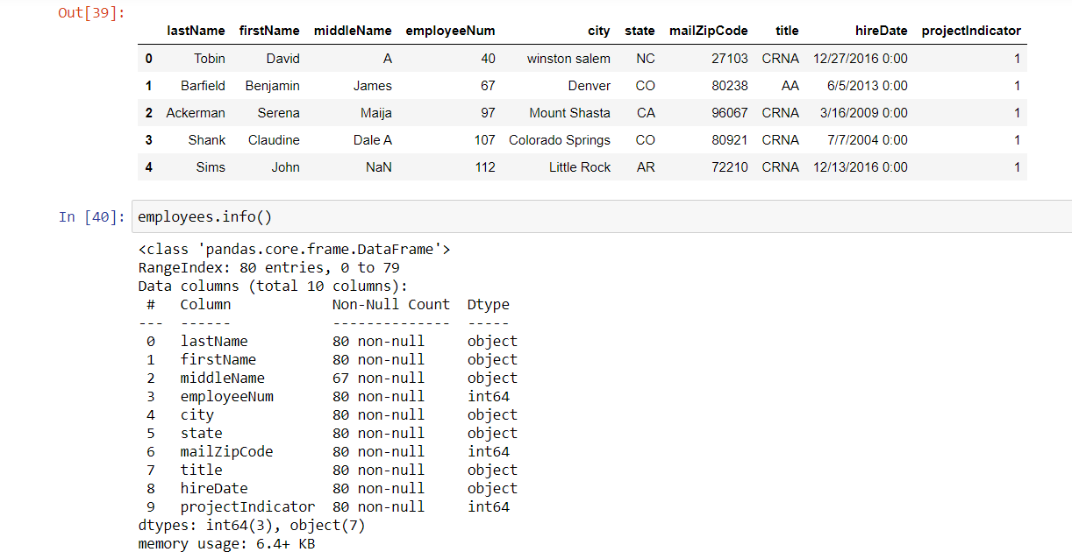
Employee File Example

Slide 12
Transform Highlights

Slide 13
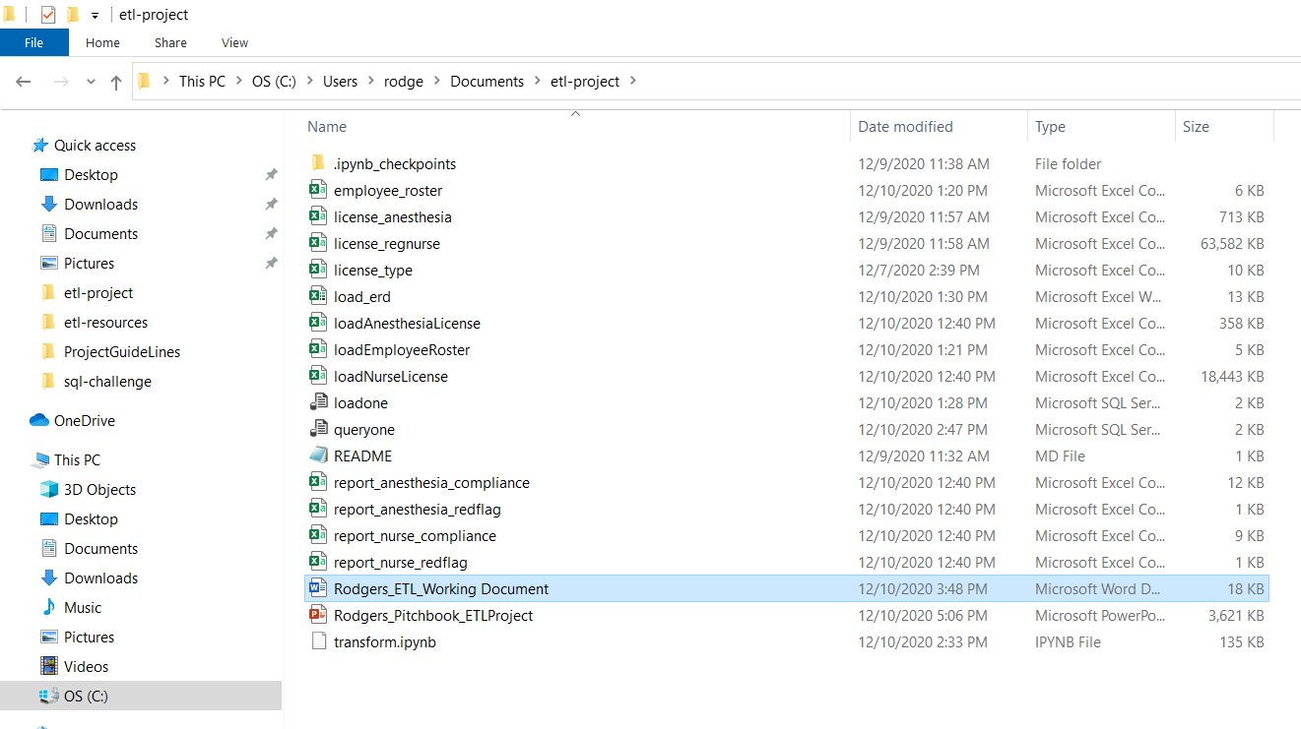
Local Project Repository
Extract Output
Transform Output
Compliance Reports

Slide 14
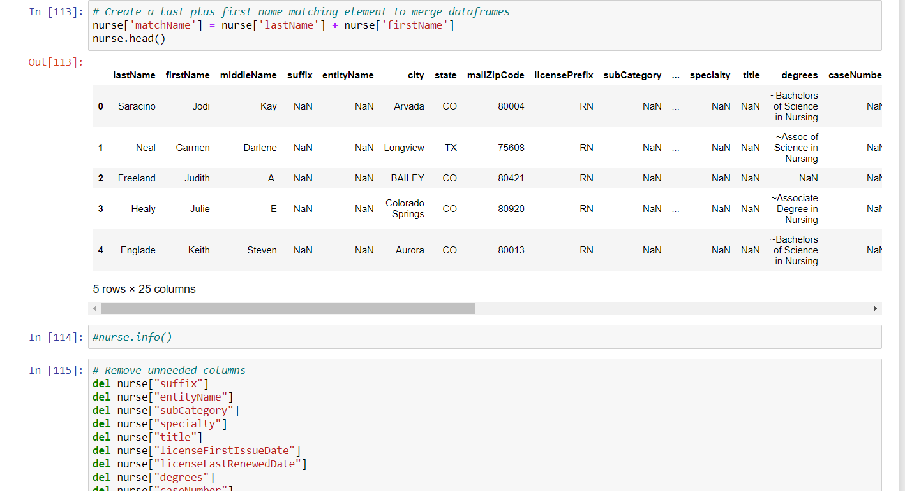
Notebook Example

Slide 15
Load Highlights

Slide 16
Entity Relationship Diagram

Slide 17
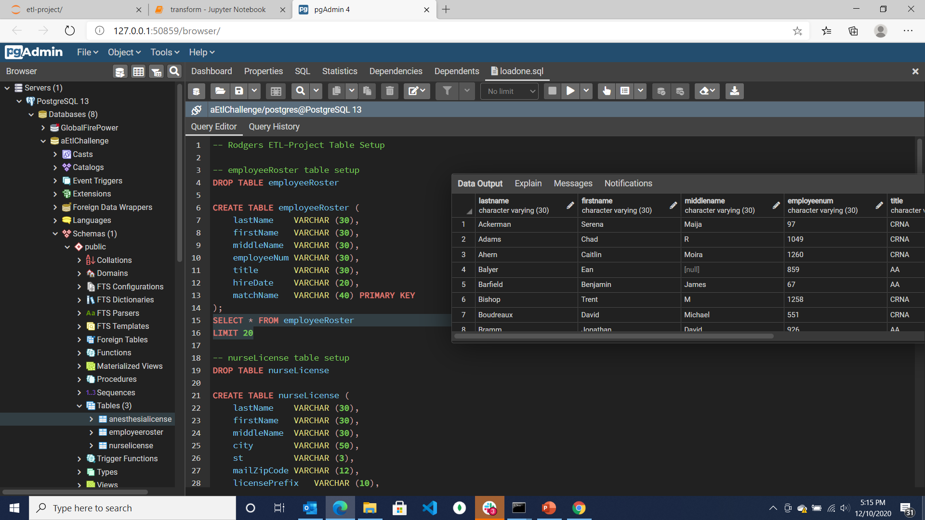
Table Schema - employeeRoster

Slide 18
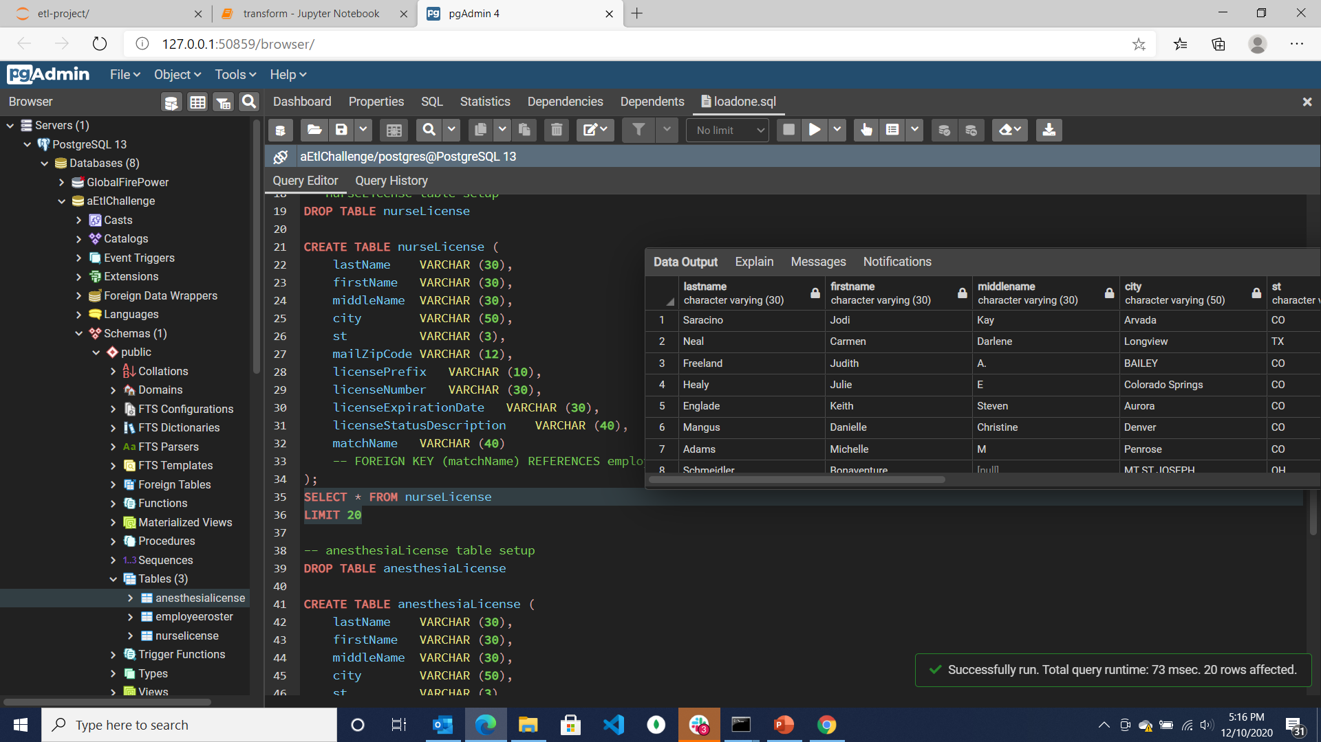
Table Schema - nurseLicense

Slide 19
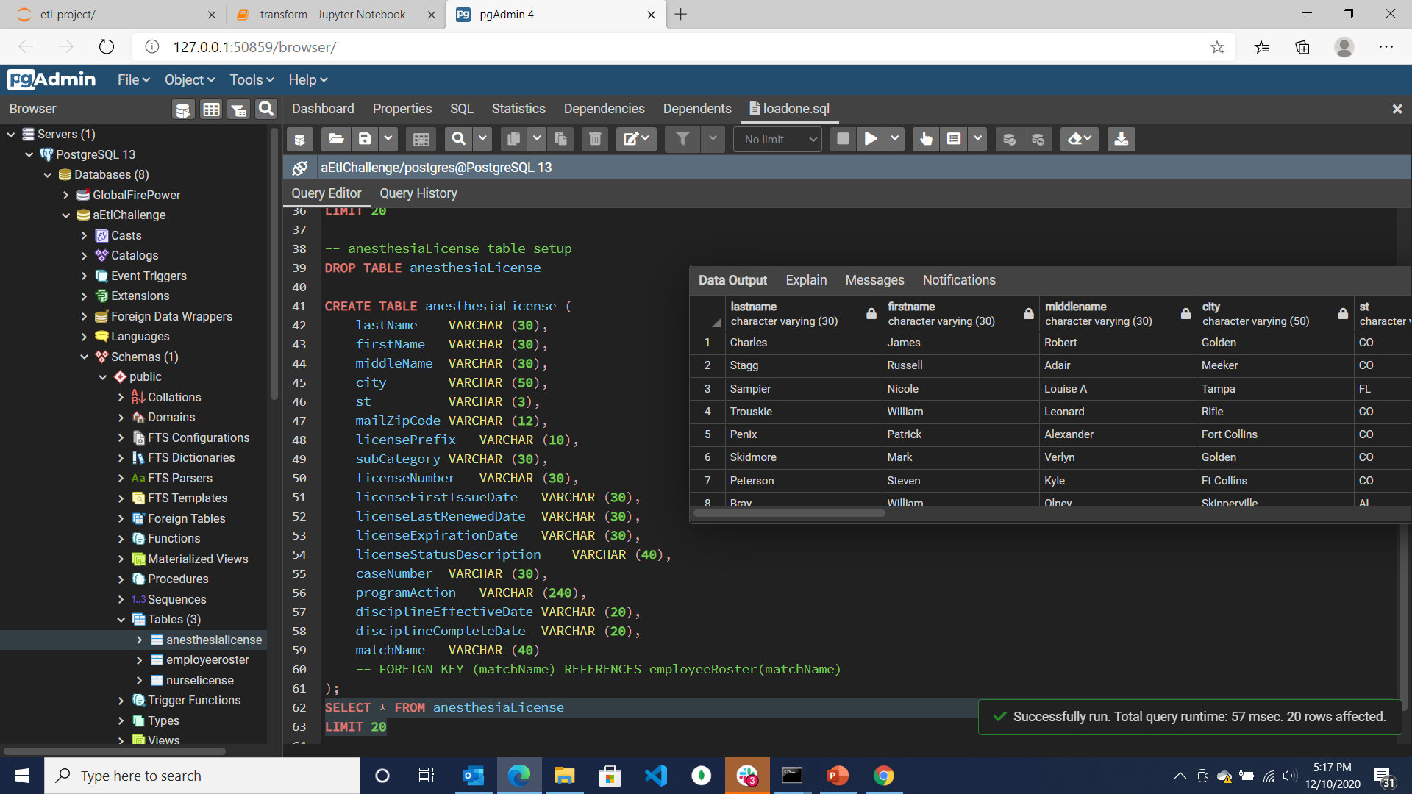
Table Schema - anesthesiaLicense

Slide 20
Ancillary Resources Associate Websites (Out-of-scope but might use later)

Slide 22
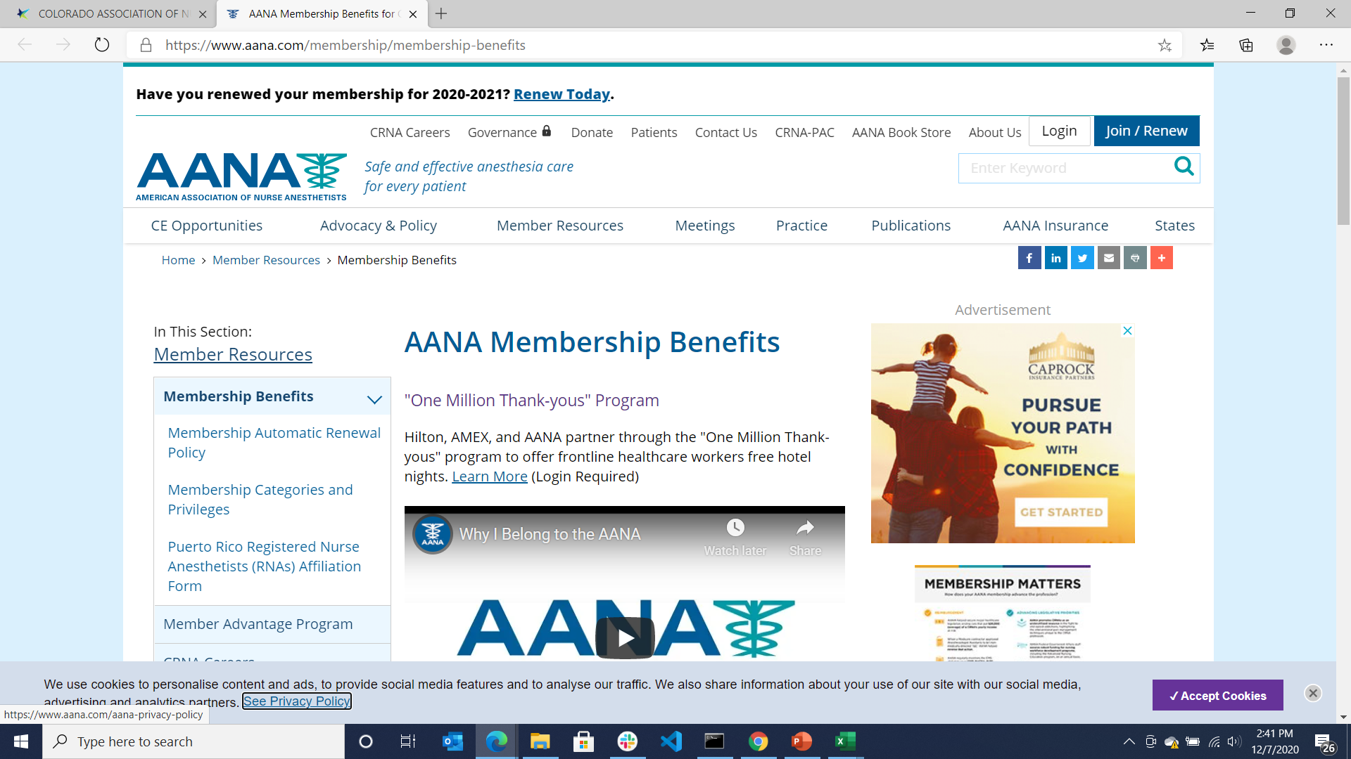

Slide 23
Original Project Proposal
Pull professional licensing data from Colorado.gov and create a reporting process to better manage expired and pending expiration licenses.
Extract
Ideally – utilize an API from the CO-DORA license listing that is updated daily.
Add fictitious employee file to align with the state licensing status (fabricated with publicly available info)
Add the state license expiration and license name information if needed form “Professional-Types” csv
Cleaning:
Narrow the dataset to the appropriate license types, i.e. separate anesthetists from the other professional types such as plumber or electrician.
Drop unnecessary information required to meet the license management process (simplify)
Determine if additional information is needed for the underlying RN license
Note: Out of state / compact license will not be included in dataset, missing RN license will be part of risk reporting later in project
Load
Load to a PGAdmin database with the idea that the data set might provide feeds to third-party credentialling software such as Apogee or scheduling software such as Qgenda.
See the value
Join the dataset with the states license type and reoccurring expiration data cycle dates
Join the dataset with a (fabricated) employee file based on license number and/or name
Produce a report of “at-risk clinical employees” whose licenses show a) expired or b) about to expire (w/in 30 days)
Ancillary, determine number of practicing CRNA and AA’s in state of Colorado … always wondered

